Slide 1
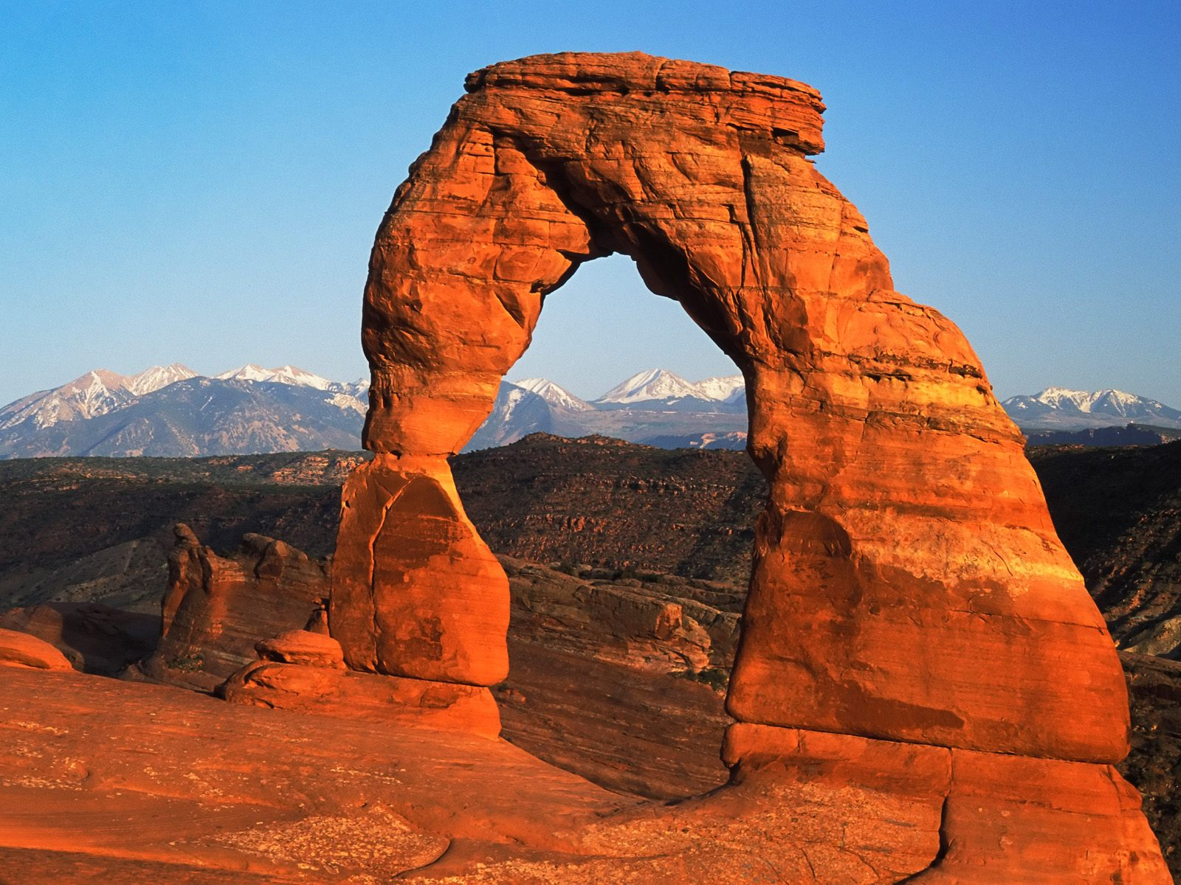
Weathering and Erosion
By: Diedrick & Maddex
Notes:
11/20/2017
1
1
1

Slide 2
Weathering
•Breaks down natural materials.
•Weathering breaks down materials into smaller pieces.
•Weathering may also break down human made structures like roads, buildings, or bridges.
Notes:
11/20/2017
2
2
2

Slide 3
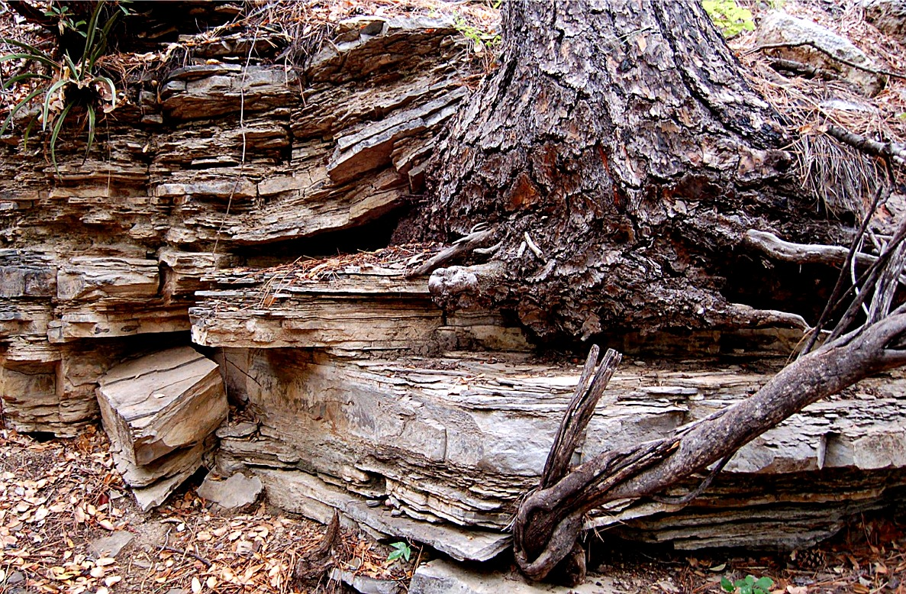
Mechanical Weathering
•Mechanical Weathering is caused by some sort of physical force.
Example 1
•Ice Wedging is when there are cracks in the ground and rainwater gets into them. In the cold weather the water freezes and the water expands making the crack widen.
Example 2
•Wind carries particles through the air and wear down exposed surfaces and turns them into smaller bits.
Example 3
•Waves can put so much power and pressure on rocks on the shore or on the ocean floor, causing the rocks to break down.
Example 4
•The weight of glaciers are so heavy that they start to go downhill. While going downhill the glacier traps rock that scrape the ground.
Notes:
11/20/2017
3
3
3

Slide 4
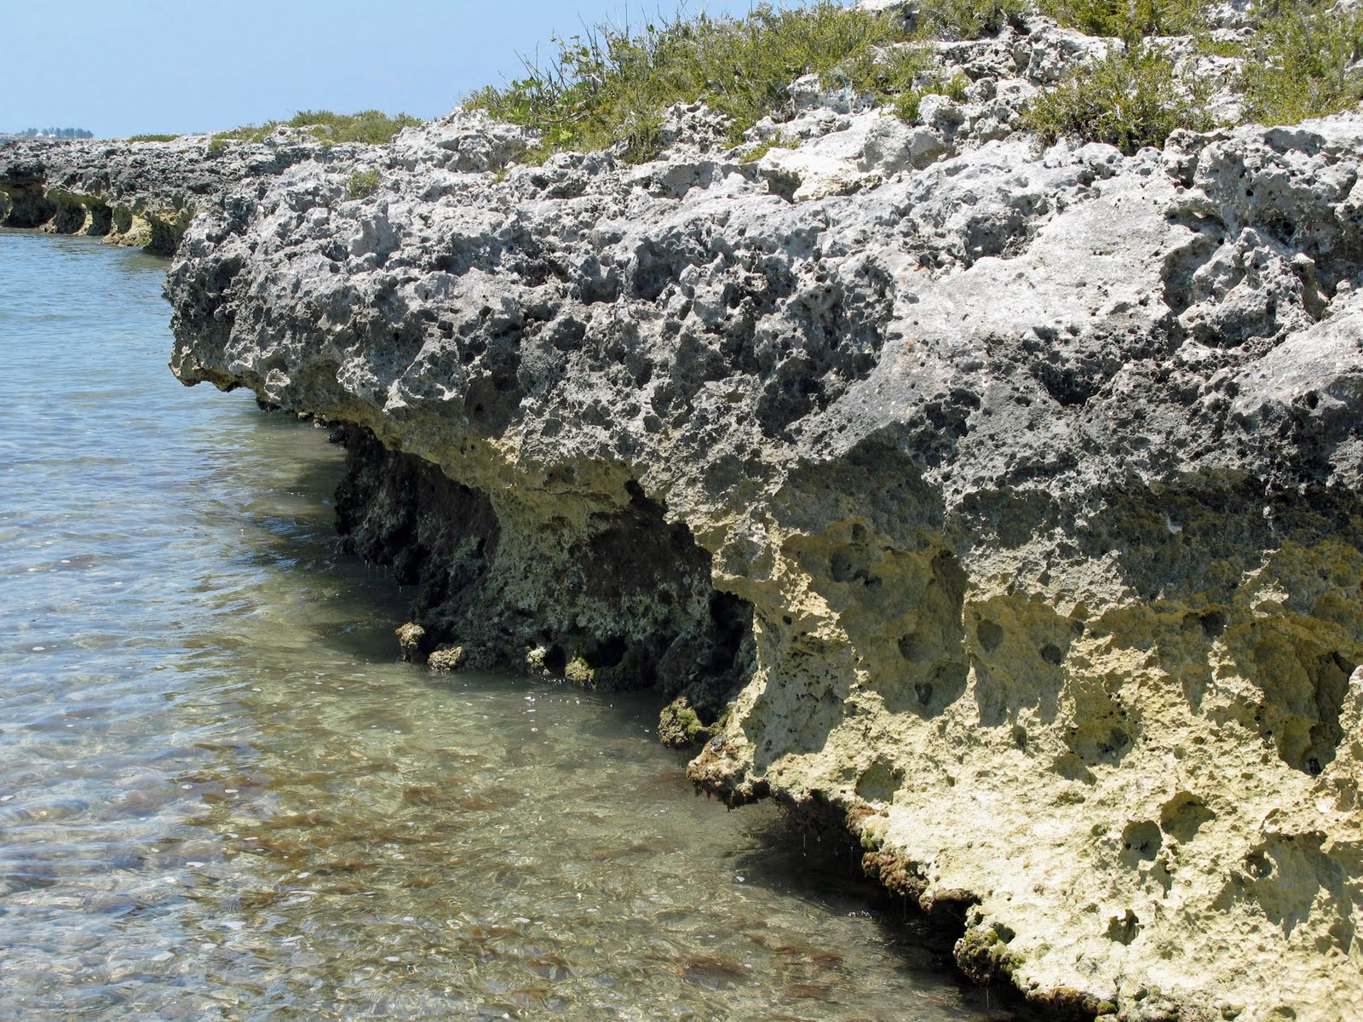
Chemical Weathering
•It occurs when there is a chemical reaction.
•It weakens and breaks down materials.
Example 1
•Water can dissolve rock materials if it contains acids, the acid breaks limestone then makes a hole/cave.
Example 2
•When acid rain is falling it can cause limestone to crumble.
Example 3
•The oxygen in air can rust any iron, in minerals that are in rocks.
Notes:
11/20/2017
4
4

Slide 5
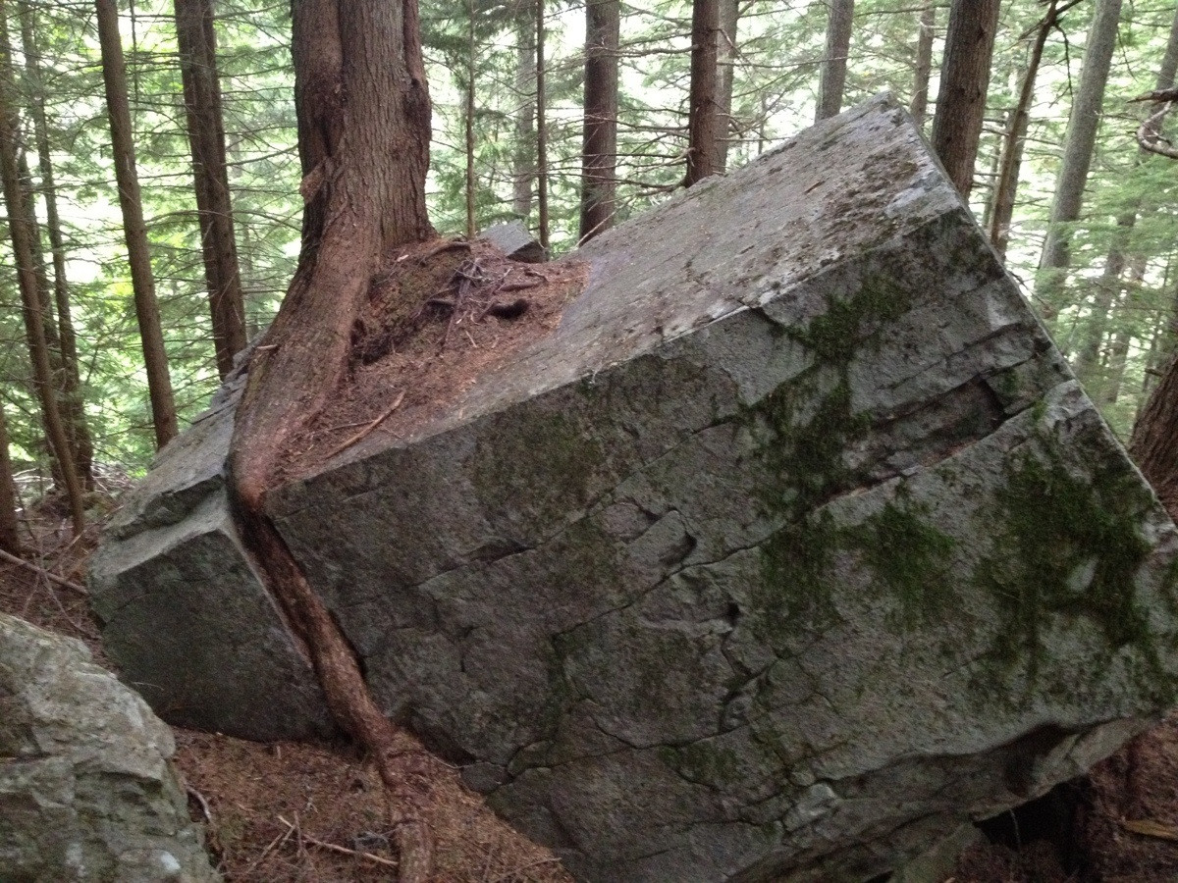
Biological Weathering
•Living things that cause mechanical and chemical weathering.
Example 1
•Lichen that grows on rocks can wear down that rock.
Example 2
•Trees that grow in cracks can help split the rock for water to come in and freeze turning into ice.
Notes:
11/20/2017
5
5

Slide 6
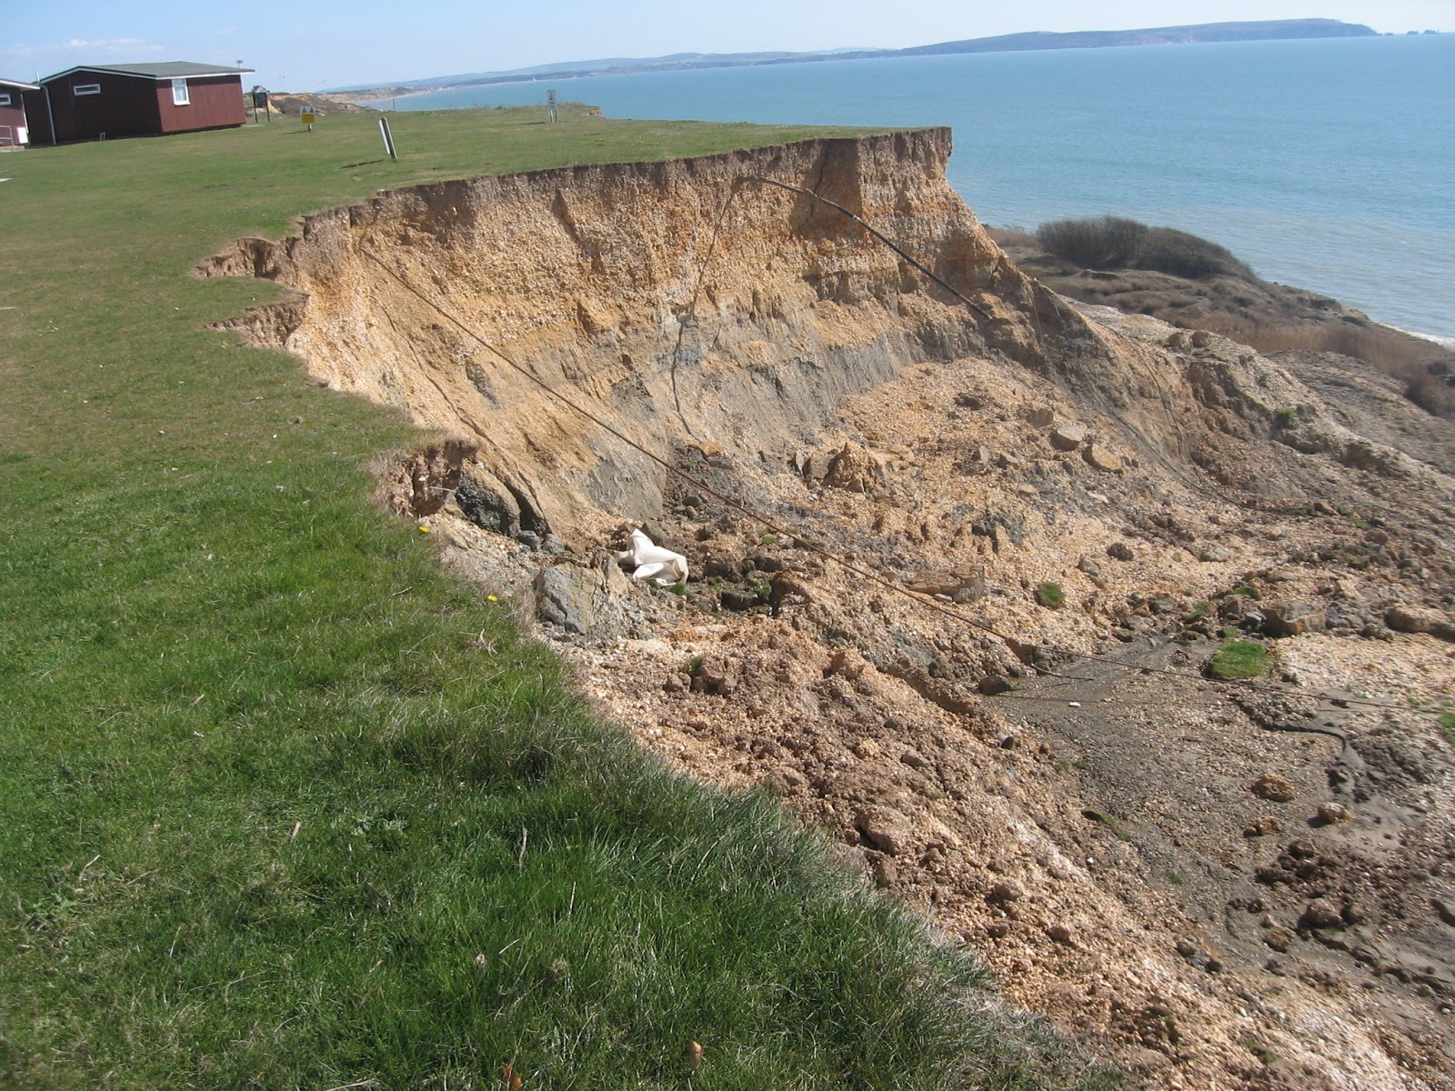
Erosion
•Erosion is the movement of weathered rock, causing the rock to deposition from one place to another.
Example 1
•Erosion can occur fast by gravity and wind.
Example 2
•Erosion can occur slowly by water and ice.
Notes:
11/20/2017
6
6

Slide 7
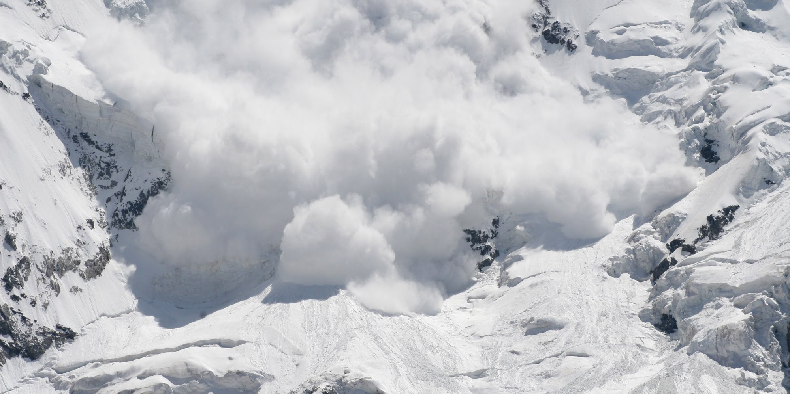
Gravity
•Gravity causes things to fall and stay put on the Earth’s surface.
Example 1
•Gravity causes rocks to fall creating avalanches that break the rocks into smaller bits.
Notes:
11/20/2017
7
7
7

Slide 8
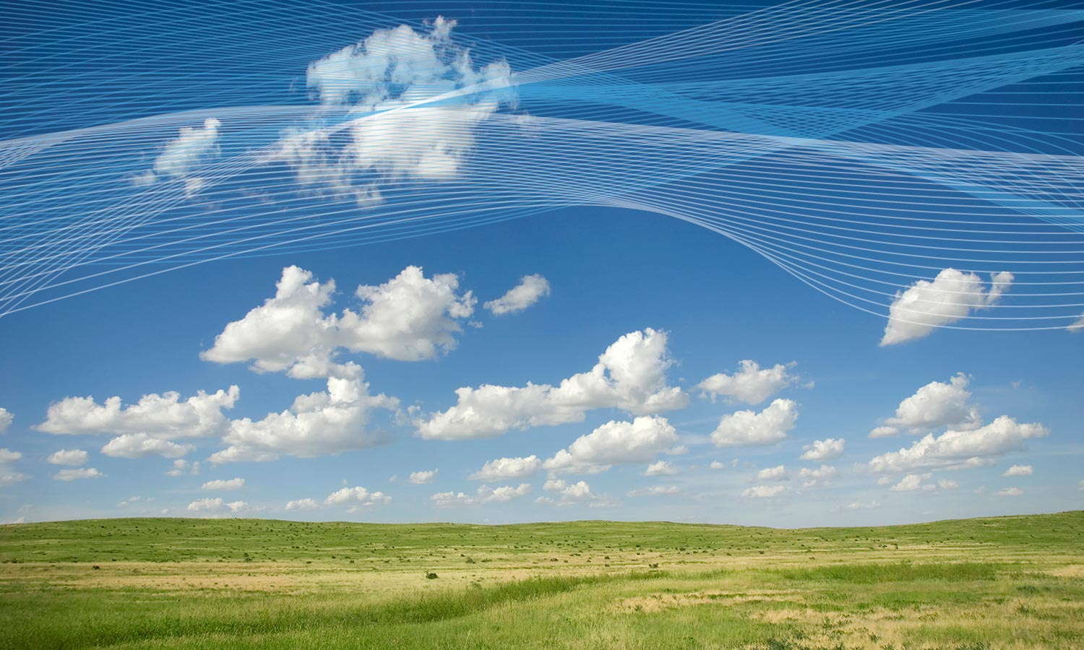
Wind
•Wind can carry particles like dirt sand etc. in the air from one place to another.
Example 1
•Wind carries particles and takes off layers from the ground to another place.
Notes:
11/20/2017
8
8

Slide 9
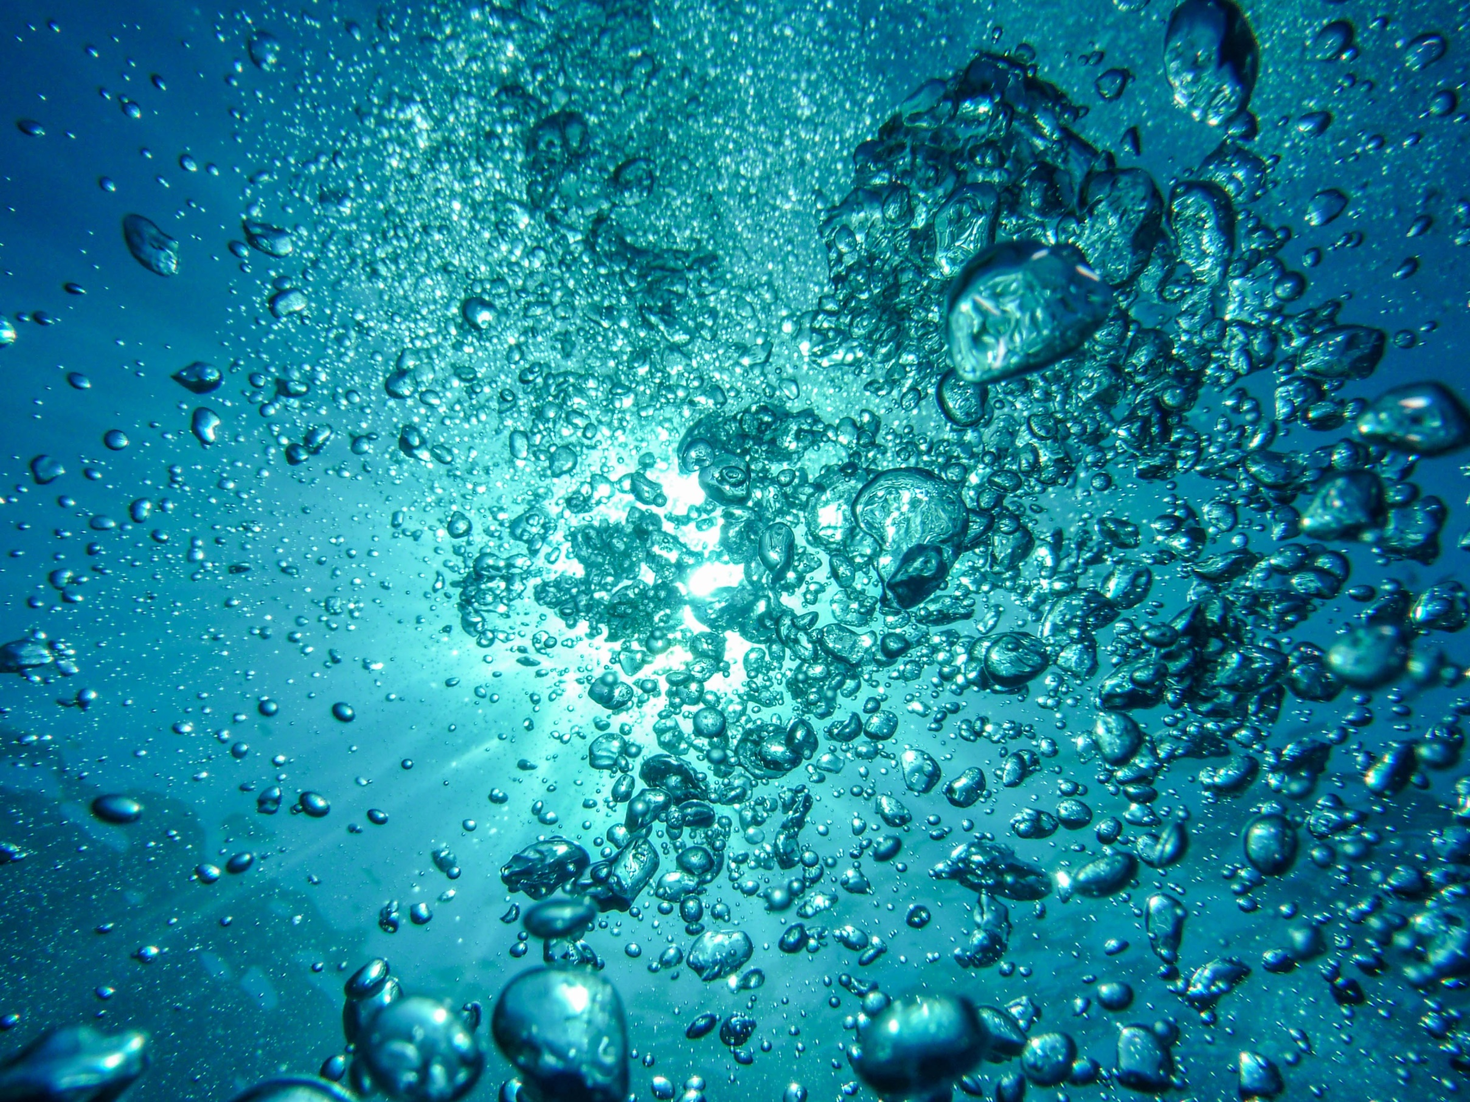
Water
•A river full of water can carry big or small particles to a lake or an ocean putting layers of sediment into a lake or ocean.
Example 1
•Rivers can cut into the land and make deep valleys.
Example 2
•rivers that carry sediments while passing through plains or another flat area puts layers of sediments causing the river to break into two making a delta.
Notes:
11/20/2017
9
9

Slide 10
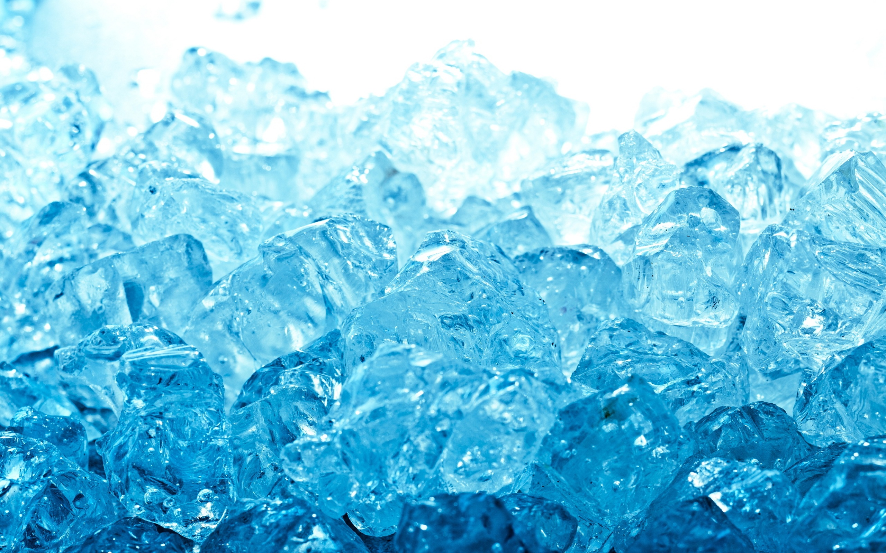
Ice
•Glaciers put pressure on to snow in the glacier making the snow turn into ice and the glacier has so much weight that in goes downhill very slowly.
Example 1
•Rocks that are frozen in ice are carried with the glacier making the rocks end up in an unusual location.
Example 2
•The ice that moves down a mountain side causes some mountains to make a U-shaped valley that became full of sea water and left fiords along coastlines.
Notes:
11/20/2017
10
10

